Slide 1
Project Presentation & Demo
Ashutosh Korde(Summer Intern Siemens DISW)

Slide 2
Problem statement
Solution approach
Demonstration of the solution
Key take aways / learnings from the project
Improvements & Future work
Q&A

Slide 3

Problem Statement
Creating utility to import Bulk Vendor Data into Teamcenter from a CSV .
Streamline and automate the process of onboarding multiple vendors by enabling users to efficiently import large volumes of vendor data into Teamcenter directly from CSV files, reducing manual effort, minimizing errors, and accelerating data integration.

Slide 4
Solution Approach
Leveraged csv2tcxml & tcxml_import utilities to avoid reinventing the wheel.
Created a SOA service which executes csv2tcxml & tcxml_import utilities to achieve bulk data import from a csv.
Used FMS for secure file handling, ensuring safe upload/download of the file during the complete process execution.
Provided user-friendly UI in the active workspace for users to execute Bulk Vendor Data Import utility.

Slide 5
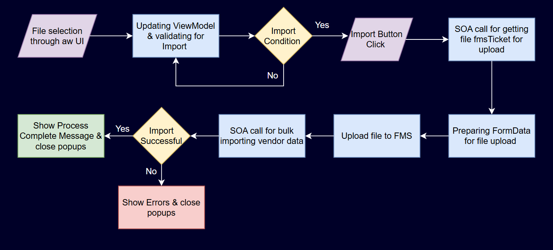
Process Flow

Slide 6
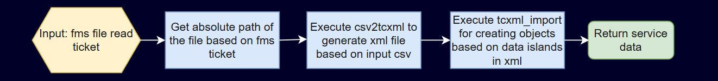
Utilities Overview & SOA Architecture
CSV2TCXML
The utility converts data provided in the csv into tcxml.
Relations between the objects needs to be defined in the header of the csv.
Existing admin objects such as user can be referred using their candidate key.
Must contain a primary object in csv in each row for islands to be created around it.
TCXML_IMPORT
The utility creates the objects island by island present in the tcxml file.
Refers to stub objects at the instance of object creation if referenced object does not exist.
We use the utility in -bulk_import mode to use POM level api’s for fast import.
In case of failure generates xml file with failed island data.
SOA Architecture

Slide 7
Solution Demonstration

Slide 8
Learnings
Server Side Development
Gained practical experience with Active Workspace’s ViewModel-driven UI architecture and event-driven workflows.
Developed and integrated custom UI panels and actions using JSON ViewModels and JavaScript services.
Learned to interact with Teamcenter SOA/REST APIs for dynamic data handling and file operations.
Gained basic knowledge of FMS for secure file handling and used related services while development.
Learned best practices for modular, maintainable, and scalable client-side code in enterprise applications.
Client Side Development
Learned creating SOA to handle business logic as in the case of creating objects related to vendor.
Gained basic knowledge about antification and antbuild for building the code. Learned how to debug build errors regarding dependencies, syntax, etc.
Learned integrating SOA in server environment to interact with client side.
Gained knowledge of utilities like csv2tcxml & bulk_import. Figured out their working and scope.
Gained hands on experience in using opengork, teamcenter developer guide to learn from codebase and documentation.

Slide 9
Key Takeaways
Gained understanding of enterprise PLM systems & developed initial insights into how customization of their data models, workflows, and integrations is done to fit different business needs.
Gained valuable insights into managing and organizing a large-scale Teamcenter codebase, including the use of abstraction and modularity. Learned how these principles are applied to maintain clarity, flexibility, and long-term sustainability in enterprise PLM systems.
Enhanced my skills in understanding code, visualizing process flows, debugging.
Overall as a first experience in corporate shrugged my nervousness and built confidence in my ability to contribute and be productive in a professional environment.

Slide 10
Improvements & Future Steps
Error handling needs to be more robust and thoroughly tested to ensure meaningful error propagation, structured error codes.
File validation needs to be added to check the syntax of content in the CSV file.
Limitations in mapping functionality of utilities needs to be overcome in order to give more options for users to use different attributes of objects to be referred.
POC to Productization.

Slide 11
Acknowledgement
Manager
Chandar Panjwani sir.
Mentors
Praveen Kamatnurkar sir.
Priyanka Bhise mam.
Ishrat Shaikh sir.

Slide 12
Q&A

